Slide 1
Guard AI
Connor Wilby

Slide 2
Original plan
New Plan
2D
Oxygine
Many supporting systems
Pathfinding
Multi-agent
Behaviour tree command structure
Hierarchical command structure
C++
Unity
3D
Supporting Systems:
Behaviour tree
Pathfinding: Unity Navmesh
Viewcones/detection system
Notes:
The original plan was to create this in 2D using Oxygine, which is a C++ game engine. I was also planning to create multiple supporting systems my project would need.
Unity: The decision to move away from Oxygine was made fairly early on, after I had spent approximately 4 weeks trying, and failing, to set Oxygine up, I realised that spending more time with it would be counter-productive, as even if I could make it work, I would still need to learn its intricacies. Unity was a game engine I knew, and it removed a significant learning curve from this project.
3d: The decision to move to 3D has a number of bonuses, but the primary reason for changing it was for the pathfinding. After a conversation with Chris, he suggested that I remove some of the sub-systems (that were fairly significant) in order to focus on the core of my project, the AI. In addition, it makes my project a lot more portable and useful, since any 3D Unity game that uses the Navmesh could use it.
Behaviour tree: The behaviour tree is the core of this assignment and is therefore what I will focus on before I start anything else.
Pathfinding: Unity navmesh provides a solution to the problem of pathfinding, as well as offering 3D and multi-level levels. This makes my project a lot more versatile, as typically (though not universally) systems like this would be used in 3D games and would be a lot more interesting to potential employers. In addition, Navmesh can use NavMesh Obstacles to effectively achieve multi-agent pathfinding, which is a system that I originally wanted to implement.
Viewcones: I have become very interested in the sight and detection systems used for a stealth AI, more so after watching a GDC talk on how it was handled in Spliter Cell:Blacklist. This is a system I will need to implement.

Slide 3
Currently implemented
Composites:
Selector
Sequence
Decorators:
Succeeder
Failer
Repeater
Notes:
These are the nodes I currently have implemented, these are all structural and can be reused.

Slide 4
Behaviour tree plan
Priority behaviour sections
Player spotted
Guard searching
Secondary behaviours
Patrol
Stationary guard
Idle
Tertiary behaviours
Specific idle
BARK system
Notes:
I have split up the sections my behaviour tree needs to have in order to create an interesting AI. You can see here that I have prioritised them, I will be working on the Player Spotted behaviour first, and then working my way down the list.

Slide 5
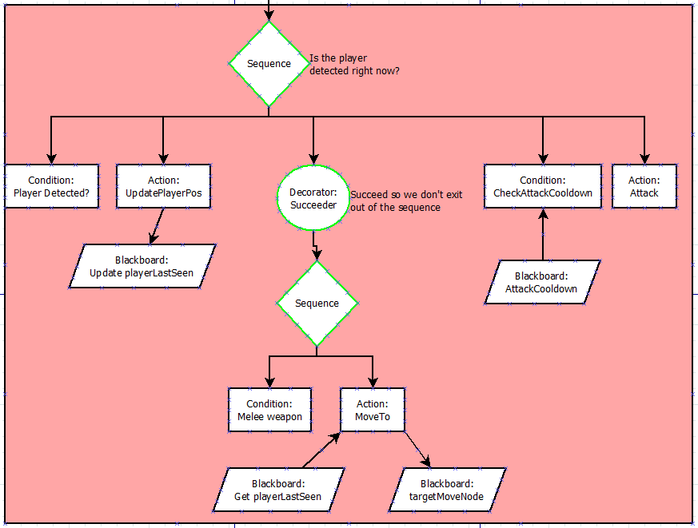
Player Spotted Sub-tree
Notes:
Here is my plan for when a guard spots the player,
They check if the player has been detected, If not then the node returns false and the sequence fails, and then moves on to the next sub-tree.
If the player has been spotted, the blackboard is updated with the player’s position.
Then there is a sub tree that works out if the guard has a melee weapon and if they do, to move to the players position.
Then they check if their attacks are on cooldown and attacks them.
I should probably check if the player is in range here.

Slide 6
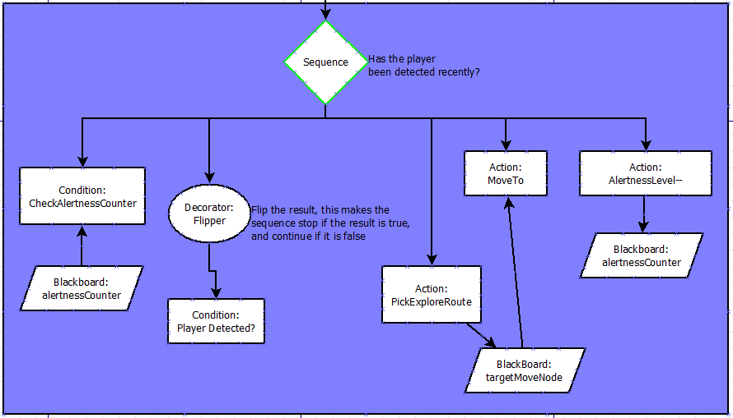
Search Sub-tree
Notes:
Here we have the search sub-tree, where the guard checks if it is still alert, then checks if the player has been detected, explores the area and then reduces the alertness level by 1.

Slide 7
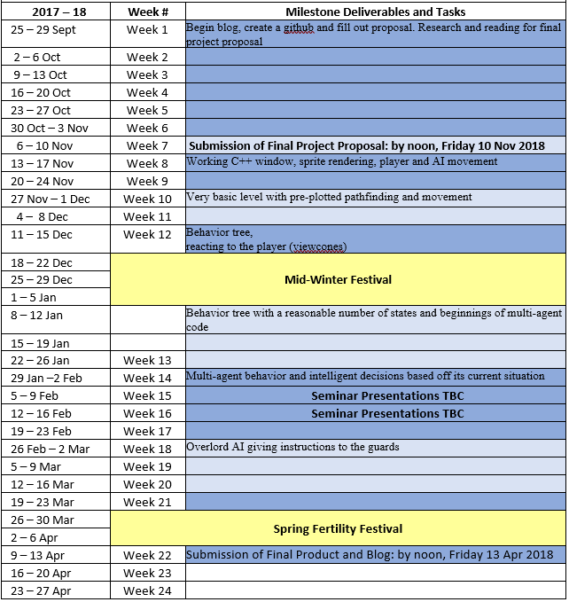
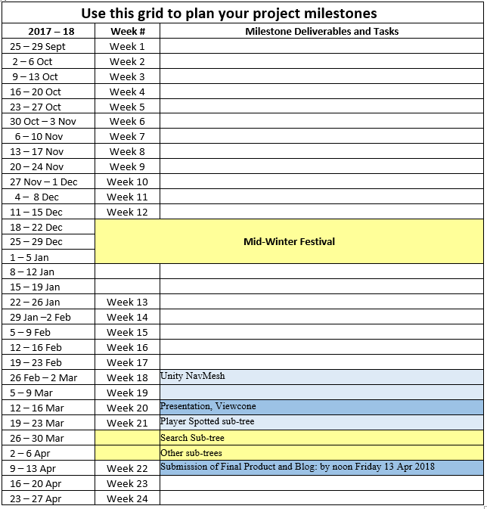
Schedule changes and reasoning
Notes:
Here you can see the changes I have made to my schedule.
The rest of this week (and some of yesterday) will be spent building a basic level and getting a feel for how Unity’s navmesh works.
After that I will work on building my behaviour tree and testing the nodes I already have.
From there I will create the nodes you saw in the previous slides for each of those sub-trees and using the behaviour tree

Slide 8
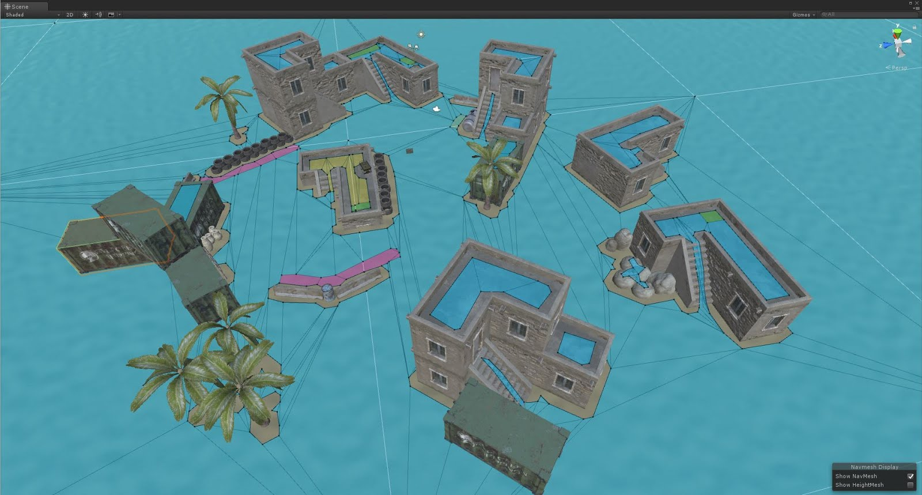
The Last Two Weeks
Notes:
During the last two weeks I have created a sample level and used Unity’s Navmesh, getting used to how the movement works with it. My next step is to create a viewcone so that my guards can actually detect when a player is in sight, then from there I will start creating my nodes, starting with the player spotted node.

Slide 9
Questions?

